Slide 1
Digital Nomad Destination Analysis
Mykolas Daugirdas
Angel Conde
Rebecca Daaleman
Patrick Moon
Moises Contreras

Slide 2
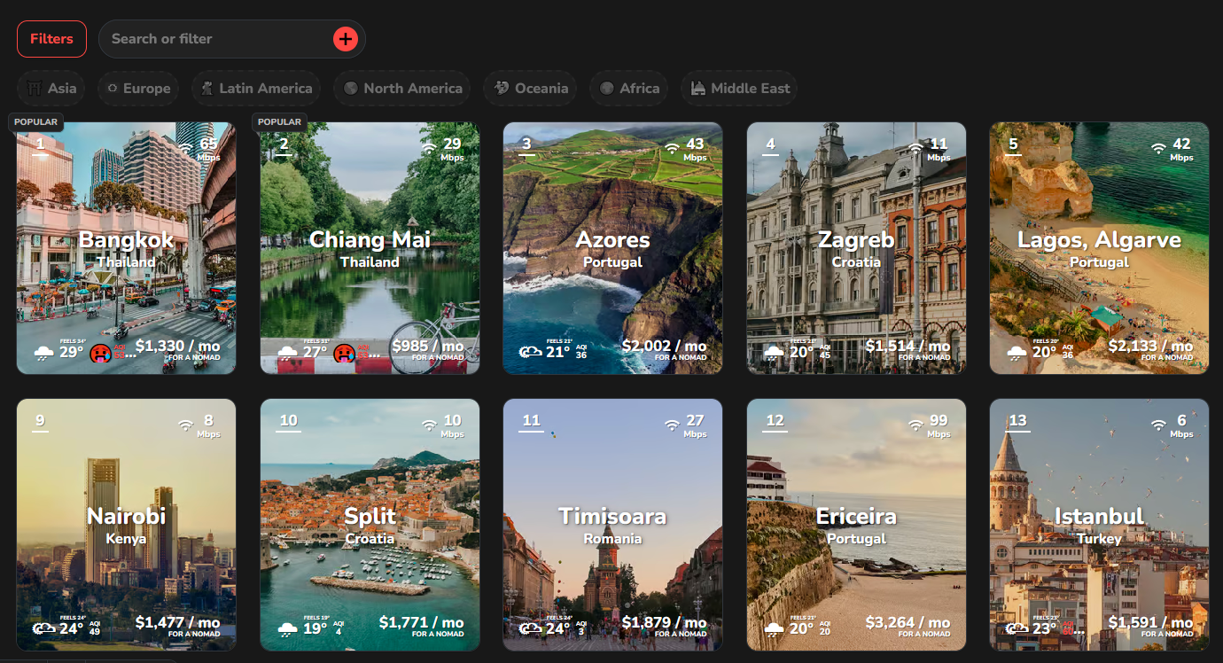
Nomad List Website API
Digital Nomads
People utilizing the current trend toward remote work
They Travel freely while working remotely using technology and the internet. Such people generally have minimal material possessions and work remotely in temporary housing, hotels, cafes, public libraries, co-working spaces, or recreational vehicles, using Wi-Fi, smartphones or mobile hotspots to access the Internet.
Nomad List Website
Community of Nomads
Provide Reviews by Location:
Total Score
Cost
Internet Speed
Safety
Temperature
Humidity
Available Entertainment
(additional key metrics)

Slide 3
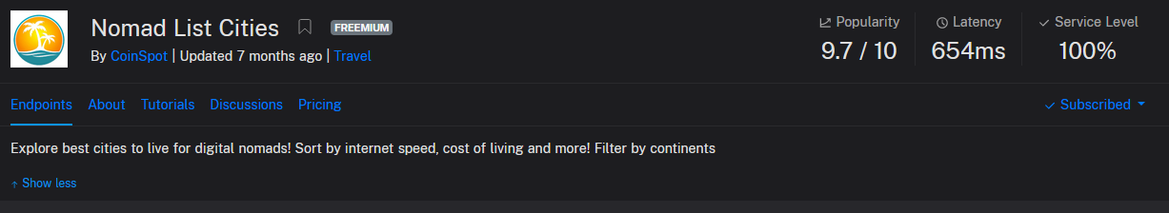
Data Source
https://rapidapi.com/emir12/api/nomad-list-cities
Cleaning Required:
Needed 7 separate pulls by continent – requiring a merge.
Extra Columns, Null Values, Emoji Columns, Combination Columns

Slide 4
Questions to Answer:
What are the key characteristics of each destination?
Which countries have the fastest internet?
Which destinations are the more affordable?
Which destinations are the safest?
Which destinations are the highest rated by digital nomads?

Slide 5
Demo Agenda:
Review of Data Model
Presentation of Dashboard Visualizations
Presentation of Interactive Leaflet Map

